Slide 1
Machine Learning With Python
Nabajyoti Pathak

Slide 2
When do we use KNN algorithm?
KNN can be used for both classification and regression predictive problems. However, it is more widely used in classification problems in the industry.
To evaluate any technique we generally look at 3 important aspects:
Ease to interpret output
Calculation time
Predictive Power

Slide 3
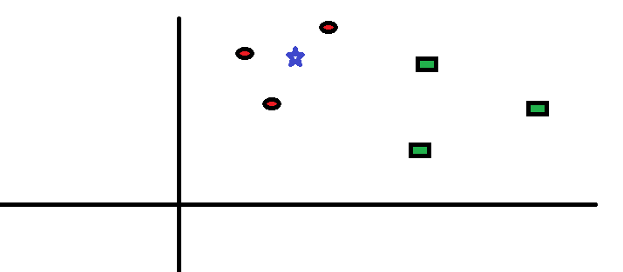
How does the KNN algorithm work?
Let’s take a simple case to understand this algorithm. Following is a spread of red circles (RC) and green squares (GS) :

Slide 4
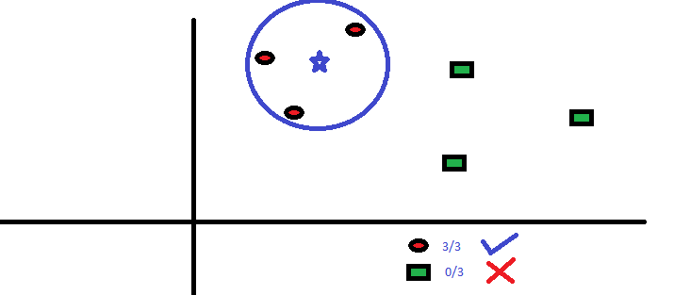
KNN
You intend to find out the class of the blue star (BS) . BS can either be RC or GS and nothing else. The “K” is KNN algorithm is the nearest neighbors we wish to take vote from. Let’s say K = 3.
Hence, we will now make a circle with BS as center just as big as to enclose only three data-points on the plane. Refer to following diagram for more details:
The three closest points to BS is all RC. Hence, with good confidence level we can say that the BS should belong to the class RC. Here, the choice became very obvious as all three votes from the closest neighbor went to RC. The choice of the parameter K is very crucial in this algorithm. Next we will understand what are the factors to be considered to conclude the best K.

Slide 5
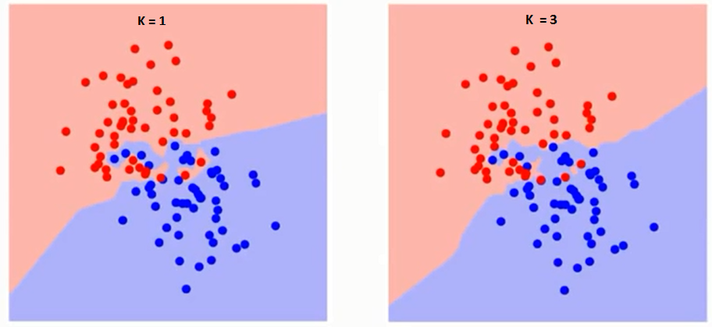
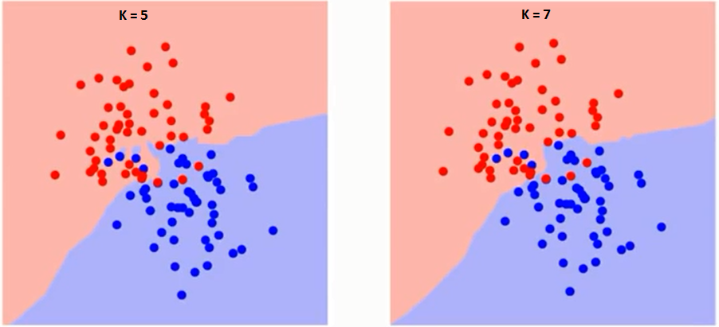
How do we choose the factor K?
First let us try to understand what exactly does K influence in the algorithm. If we see the last example, given that all the 6 training observation remain constant, with a given K value we can make boundaries of each class.
These boundaries will segregate RC from GS. The same way, let’s try to see the effect of value “K” on the class boundaries. Following are the different boundaries separating the two classes with different values of K.

Slide 6
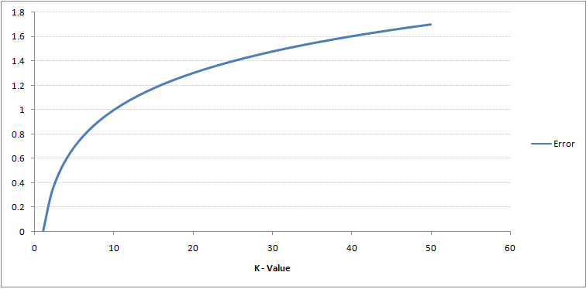
How do we choose the factor K?
If you watch carefully, you can see that the boundary becomes smoother with increasing value of K.
With K increasing to infinity it finally becomes all blue or all red depending on the total majority.
The training error rate and the validation error rate are two parameters we need to access on different K-value. Following is the curve for the training error rate with varying value of K :

Slide 7
How do we choose the factor K?
As you can see, the error rate at K=1 is always zero for the training sample. This is because the closest point to any training data point is itself.Hence the prediction is always accurate with K=1.
If validation error curve would have been similar, our choice of K would have been 1.
Following is the validation error curve with varying value of K:

Slide 8
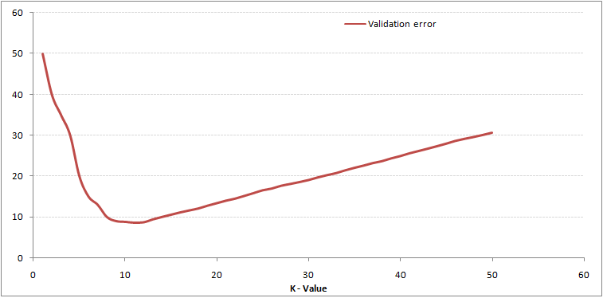
Validation error curve
This makes the story more clear. At K=1, we were over-fitting the boundaries. Hence, error rate initially decreases and reaches a minima. After the minima point, it then increase with increasing K.
To get the optimal value of K, you can segregate the training and validation from the initial dataset.
Now plot the validation error curve to get the optimal value of K. This value of K should be used for all predictions.

Slide 9
Pseudo Code of KNN
Breaking it Down – Pseudo Code of KNN
We can implement a KNN model by following the below steps:
Load the data
Initialise the value of k
For getting the predicted class, iterate from 1 to total number of training data points
Calculate the distance between test data and each row of training data. Here we will use Euclidean distance as our distance metric since it’s the most popular method. The other metrics that can be used are Chebyshev, cosine, etc.
Sort the calculated distances in ascending order based on distance values
Get top k rows from the sorted array
Get the most frequent class of these rows
Return the predicted class

Slide 10
Skill test Questions and Answers
1) [True or False] k-NN algorithm does more computation on test time rather than train time.
TRUE
B) FALSE

Slide 11
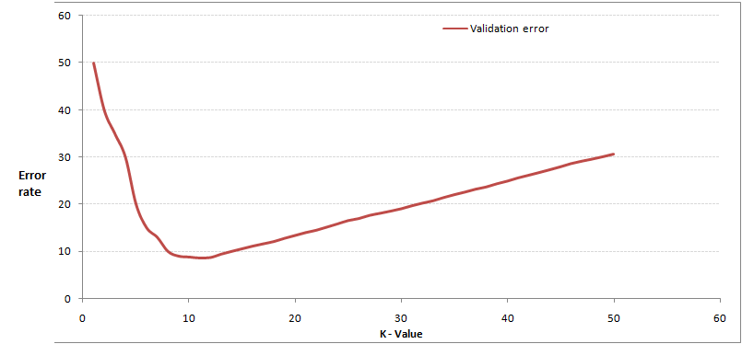
In the image below, which would be the best value for k assuming that the algorithm you are using is k-Nearest Neighbor.
A) 3 B) 10 C) 20 D 50

Slide 12
Which of the following distance metric can be used in k-NN?
A) Manhattan B) Minkowski C) Tanimoto D) Jaccard E) Mahalanobis F) All can be used

Slide 13
Which of the following option is true about k-NN algorithm?
A) It can be used for classification B) It can be used for regression C) It can be used in both classification and regression

Slide 14
Which of the following statement is true about k-NN algorithm?
1. kNN performs much better if all of the data have the same scale
2. k-NN works well with a small number of input variables (p), but struggles when the number of inputs is very large
3. k-NN makes no assumptions about the functional form of the problem being solved
4. All of the above

Slide 15
Which of the following machine learning algorithm can be used for imputing missing values of both categorical and continuous variables?
A) K-NN B) Linear Regression C) Logistic Regression

Slide 16
Which of the following will be Euclidean Distance between the two data point A(1,3) and B(2,3)?
A) 1 B) 2 C) 4 D) 8
sqrt( (1-2)^2 + (3-3)^2) = sqrt(1^2 + 0^2) = 1

Slide 17
Question
Which of the following will be true about k in k-NN in terms of variance?
When you increase the k the variance will increases
When you decrease the k the variance will increases
Can’t say
None of these

Slide 18
Why does the variance decreases in KNN algorithm when we increase the K?
large K = siimple model = underfit = low variance & high bias
small K = complex model =overfit = high variance& low bias
When K increases to inf, the model is simplest. All test data point will belong to the same class: the majority class. This is under-fit, that is, high bias and low variance.
When K decreases, lets say K=1, the granularity or resolution is too fine, which is overfit.
Overfit = high variance

Slide 19
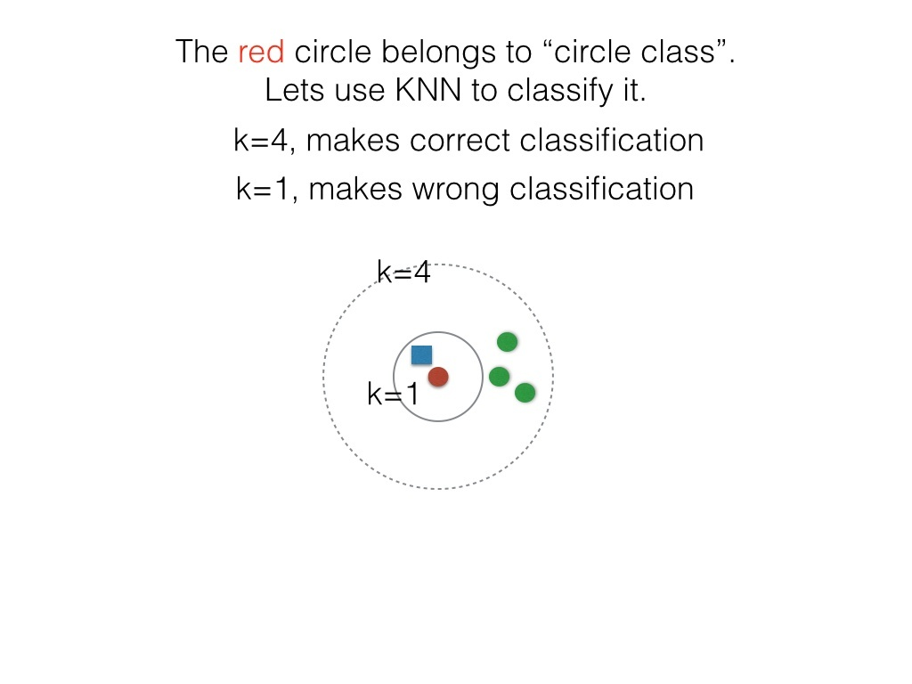
Example
The red circle as test data, is wrongly classified because the model tries too hard and its “granularity” is too fine, as a result the “outliers” and “noised” affect the decision process.

Slide 20


